Slide 1

Seminar on AI & Technology Innovation
Dr James CHAU
14 Jan 2025

Slide 2

Lecturer information
Dr. Chau Chun Pong, James
PhD in Electronic and Information Engineering, PolyU
Principal Lecturer of CPCE, PolyU
Associate Division Head of SEHS, CPCE, PolyU
Research Interests:
Image processing, video processing, pattern recognition, artificial intelligence, Integrated circuits, indoor positioning, robotics.
Tel: 3746 0237
Email: ccjames@cpce-polyu.edu.hk

Slide 3
Day 1: Wireless IoT Technologies and Applications
Introduction to IoT
Wireless IoT communication technologies
IoT applications in various industries
IoT device practice
Conclusion and Q&A

Slide 4
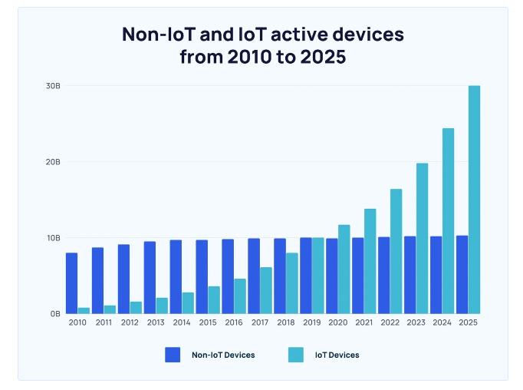
What is Internet of Things (IOT)?
It means things can connect to Internet.
How? Through the control of computer systems
Many companies starts developing their products in IOT
Intel, IBM, Microsoft, ARM, CISCO…
In 2023, over 13 billion devices are
connected to Internet.
Major technologies:
Embedded systems
Big data
RFID
Sensors
Actuators

Slide 5
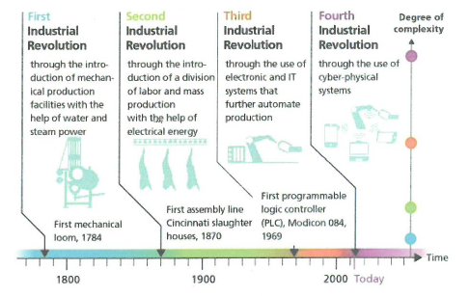
Industrial revolution

Slide 6
Smart City Development in Hong Kong
Blueprint: https://www.smartcity.gov.hk/
Objectives:
make use of innovation and technology to address urban challenges, enhance the effectiveness of city management and improve people’s quality of living as well as Hong Kong’s sustainability, efficiency and safety;
Enhance Hong Kong’s attractiveness to global businesses and talents; and
Inspire continuous city innovation and sustainable economic development
Areas:
Smart Mobility, Smart Living, Smart Environment, Smart People, Smart Government and Smart Economy

Slide 7

Example

Slide 8
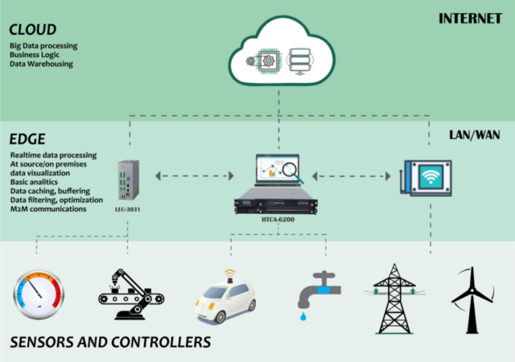
IOT model

Slide 9
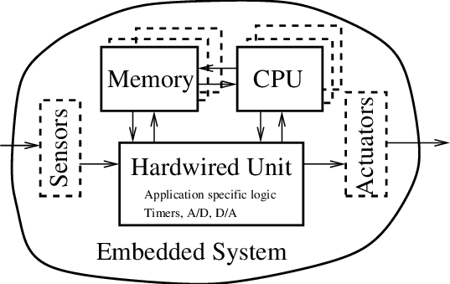
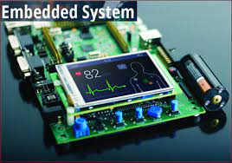
Embedded system
An embedded system is a combination of computer hardware and software, either fixed in capability or programmable, designed for a specific function or functions within a larger system.
Nowadays, they are in hand-held size, light-weighted and cheap.
Examples:
Nvidia Jetson
Raspberry Pi
Micro:bit
Arduino
ESP8266

Slide 10
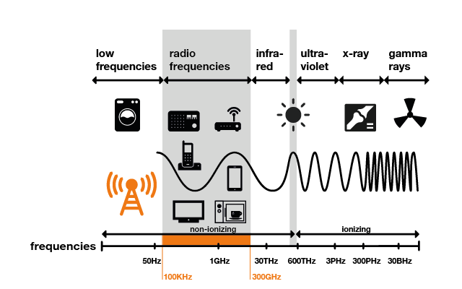
Electronic communication
Electronic communication means the transmission of data/messages between two or more locations
Nowadays, electromagnetic radiations are employed in the transmission
The messages and data are converted into their digital form for processing and transmission

Slide 11
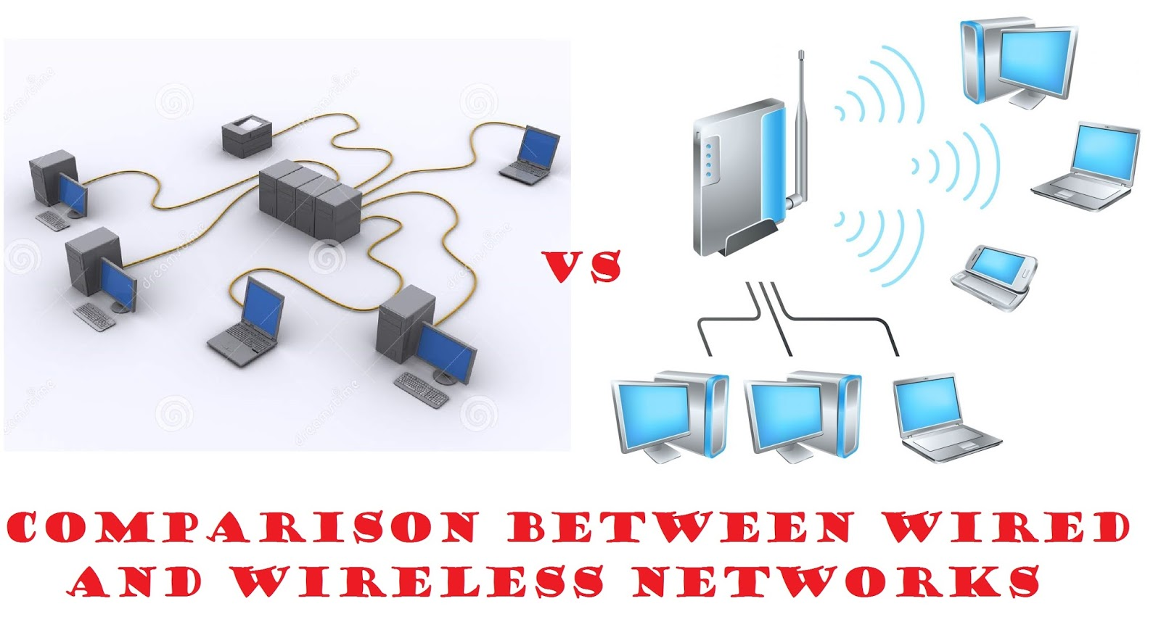
Wire and wireless communication
Wire communication
Physic connection between the transmitter and receiver is existed in terms of cable
E.g. Optical fibres
More reliable
Wireless communication
The transmission medium is air
E.g. mobile communication network
More convenience

Slide 12
Wireless IoT communication technologies
Short-range communication technologies
Range are determined by transmission power, short-range transmission devices often transmits signals using low power
Transmission distance is around 1 m to 10 m
Examples
Bluetooth and Bluetooth Low Energy (BLE)
Wi-Fi (IEEE 802.11)
Zigbee (IEEE 802.15.4)
Z-Wave
NFC (Near Field Communication)

Slide 13
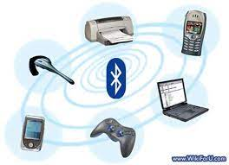
Bluetooth and Bluetooth Low Energy (BLE)
Bluetooth is now a wireless standard transmission technology
It enables communication between devices
BLE also known as Bluetooth Smart
It is a power-efficient version of Bluetooth technology
Current version is 6.x, transmission range can be up to 240 m and the maximum transmission rate is 100 Mbps, its transmission frequency is 2.4 GHz.

Slide 14
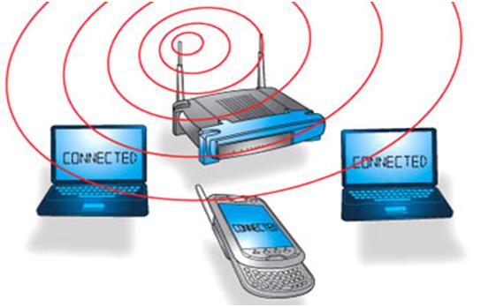
Wi-Fi
Wi-Fi = Wireless Fidelity
It is a wireless networking technology which allows the devices connect to the Internet
It uses radio waves with frequency of 2.4 GHz and 5 GHz for transmission
Current version = version 6 (802.11 ax), its maximum transmission rate is 9.6 Gbps

Slide 15
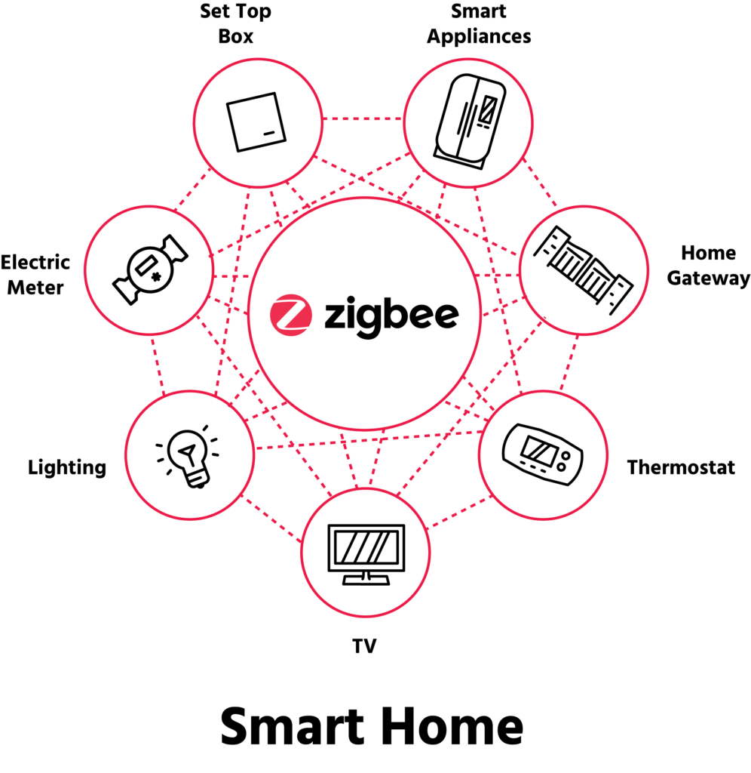
Zigbee
Zigbee is a wireless communication protocol specifically designed for low-power, low-data-rate wireless applications
It operates again in 2.4 GHz
Applications: home automation, smart lighting, industrial control systems and building automation
It supports mesh networking and can easily extend its range

Slide 16
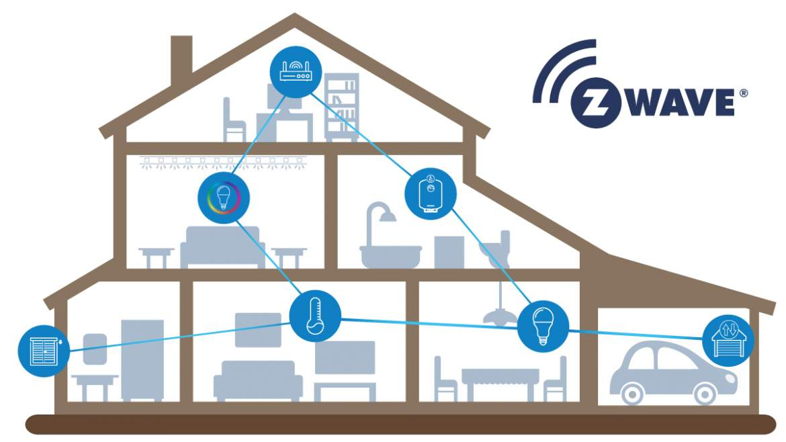
Z-wave
Z-wave is a wireless communication protocol for how automation and smart home devices
It aims at providing reliable and secure communication for the devices
It operates in 868.42 MHz or 908.42 MHz and has better signal penetration and it supports also mesh network

Slide 17
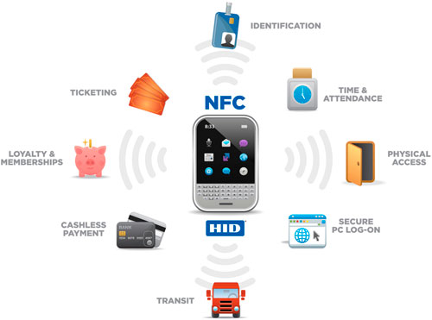
Near Field Communication (NFC)
NFC is a short-range wireless communication technology which transmit data only when the devices are brought in close proximity, usually a few centimetres
It operates in 13.56 MHz and uses Radio Frequency Identification (RFID) technology
It has already used in some contactless payment systems or device pairing up

Slide 18
Long-range communication technologies
Compared to Short-range communication technologies, Long-range communication technologies can transmit the messages between longer distances with a higher power in transmission
Examples:
Long Range Wide Area Network (LoRa WAN)
Sigfox
NB-IoT (Narrowband IoT)
LTE-M (Long-Term Evolution for machines)

Slide 19
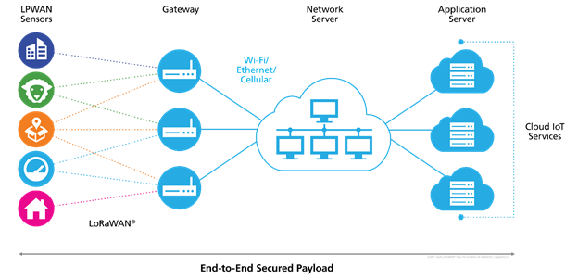
Long Range Wide Area Network
LoRaWAN is a low power, long range wireless communication protocol and it is widely applied in IoT applications
It employs 900 MHz for data transmission with good penetration ability (up to 10 km distance) but the data rates is only 50 kbps

Slide 20
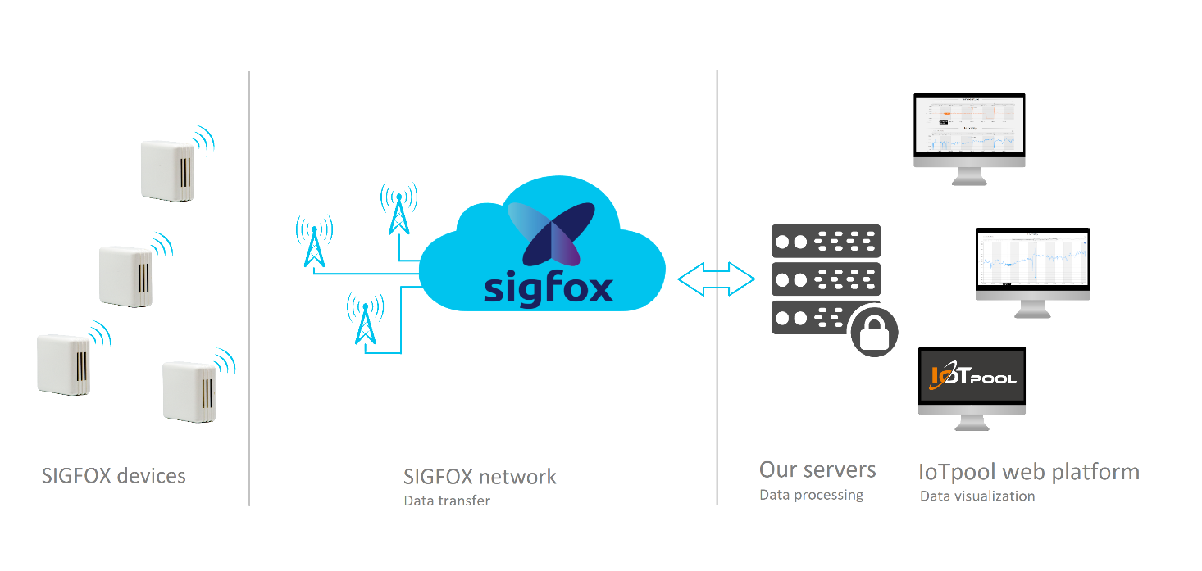
Sigfox
Sigfox is another lower power WAN technologies and it is suitably applied to IoT applications
It employs 868 MHz or 902 MHz for data transmission, but the data rate is only 100 bps to 1 kbps only
It can transmit data with a range up to 40 km and can reach the underground devices

Slide 21
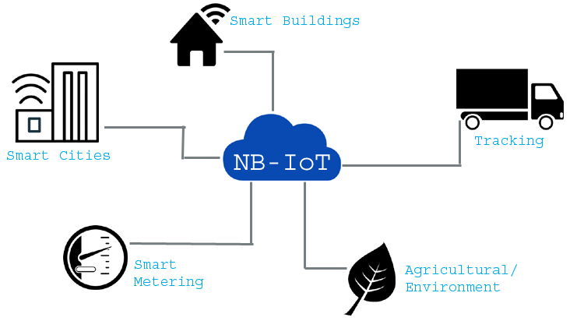
Narrowband-IoT
NB-IoT is a cellular network technology designed for IoT applications
It uses the LTE frequency bands with a narrower bandwidth (200 kHz) for data transmission
It is targeted the indoor IoT devices and its transmission range can be up to 10 km

Slide 22
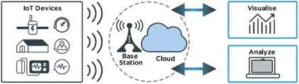
Long-Term Evolution for Machines
LTE-M is a cellular wireless standard beyond 3G. When it is applied to machines, it can provide a high data rate (up to 100 Mbps)
It can use any transmission frequency available in LTE ranged from 600 MHz to 5.2 GHz
As it can transmit in a higher data rate, it makes the power consumption of the devices become higher

Slide 23
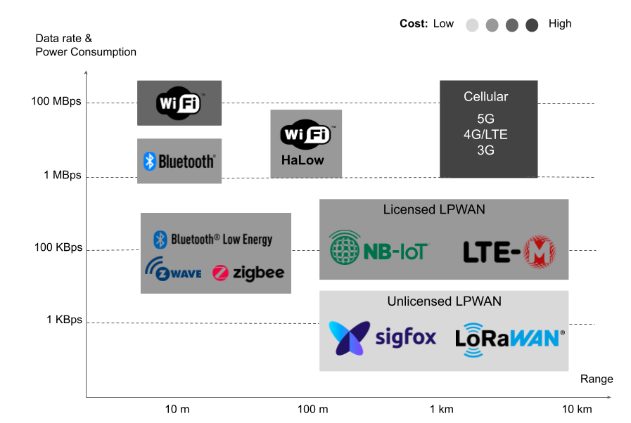
Wireless communication technology selection criteria
Range
Power consumption
Data rates
Network scalability

Slide 24
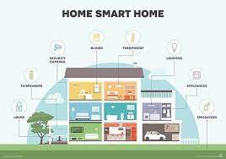
IoT applications (Smart home)
Home automation
Energy management
Security and surveillance

Slide 25
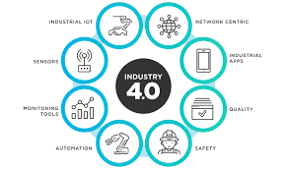
IoT applications (Industrial IoT)
Predictive maintenance
Asset tracking
Process automation

Slide 26
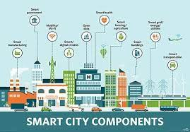
IoT applications (Smart Cities)
Traffic management
Waste management
Public safety

Slide 27
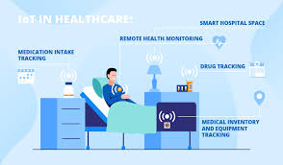
IoT applications (Healthcare)
Remote patient monitoring
Telemedicine
Wearable devices

Slide 28
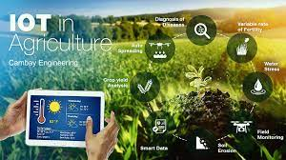
IoT applications (Agriculture)
Precision farming
Livestock monitoring
Irrigation management

Slide 29
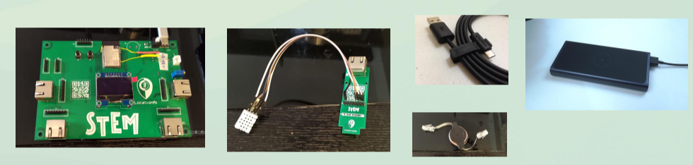
IoT practice – Smart Location IoT kit
MCU produced by STMicroelectronics
Modules that integrated with the other components and sensors
Objective: A low-cost WiFI microchip with built-in networking software and microcontroller capability

Slide 30
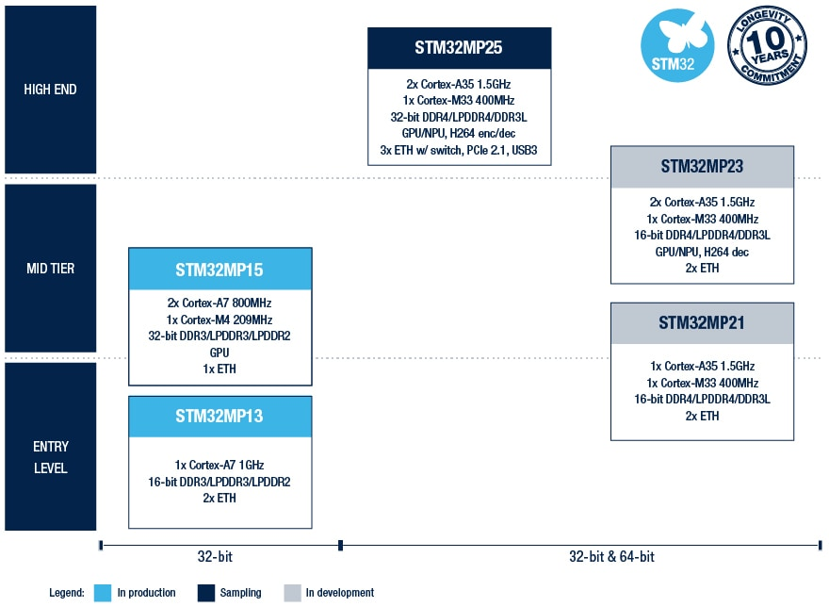
STMicroelectronics processors
Arm Cortex MPUSs

Slide 31
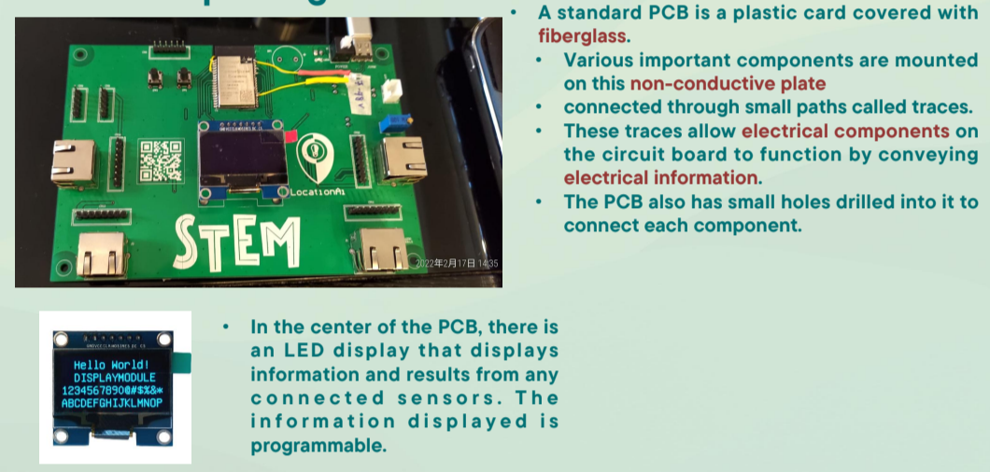
Hardware package

Slide 32
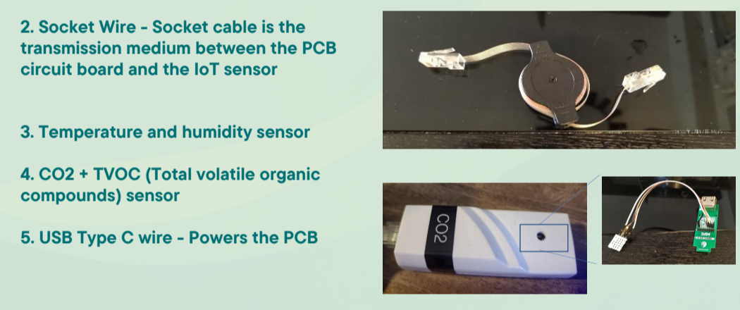
Hardware package

Slide 33
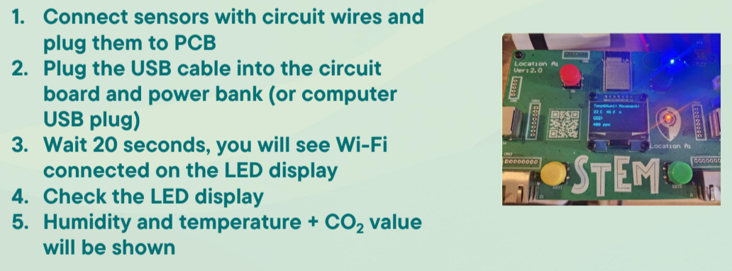
How to assemble?

Slide 34
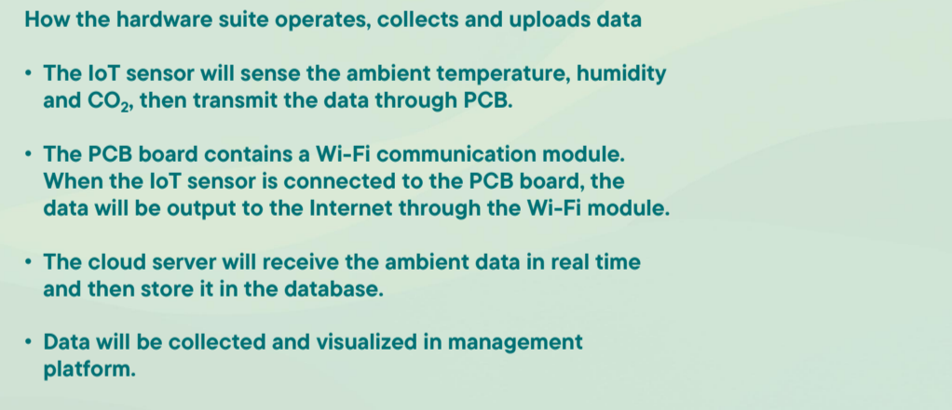
Data Analysis

Slide 35
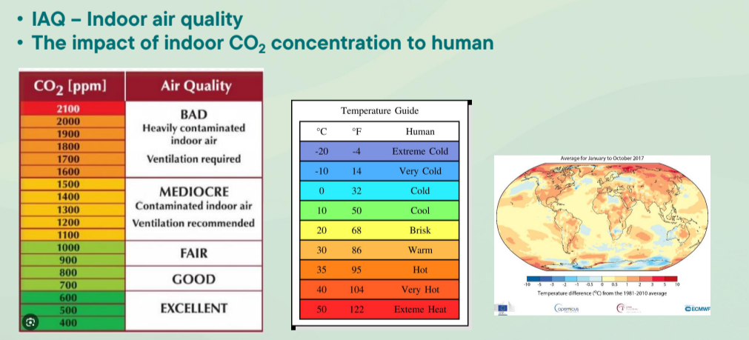
Data analysis application

Slide 36
Resource management using Github
The resources can be assessed in
https://github.com/jameschau2014/IoTplatform

Slide 37
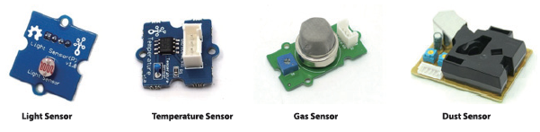
Grove environmental sensors
The Kit includes sound, temperature and light sensors

Slide 38
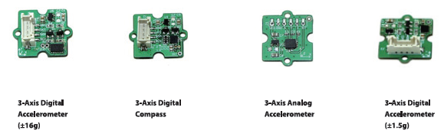
Grove motion sensors
The Kit includes touch and rotary angle sensors and button

Slide 39
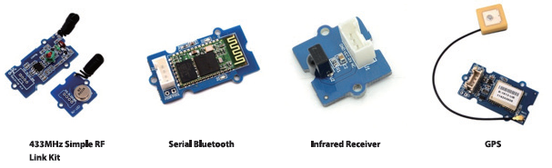
Grove wireless modules

Slide 40
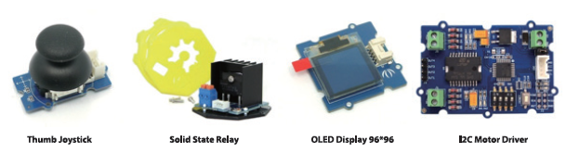
Grove user interface modules
The Kit includes buzzer, LED, LCD RGB backlight and servo motor

Slide 41
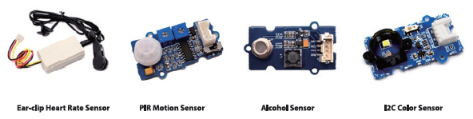
Grove physical sensors

Slide 42
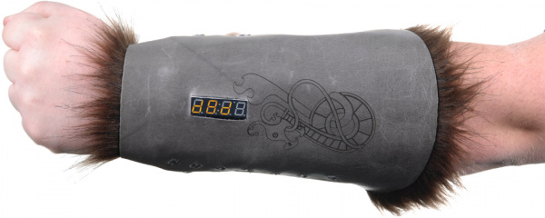
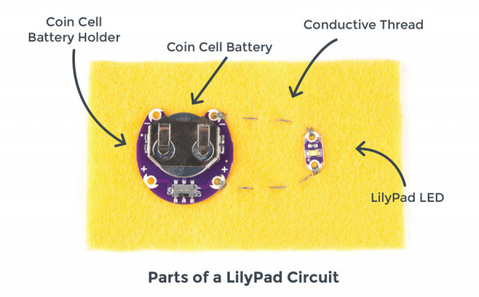


Application examples
Lilypad
For e-textile and wearable projects
D&D Dice Gauntlet
Safety scarf
Light up silk flower

Slide 43
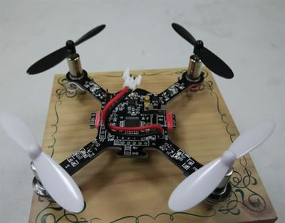
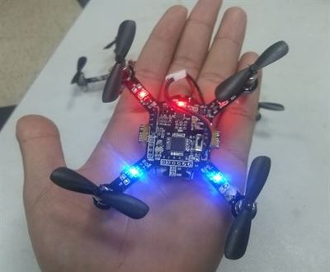
Arduino unmanned aircraft
A programmable unmanned aircraft

Slide 44
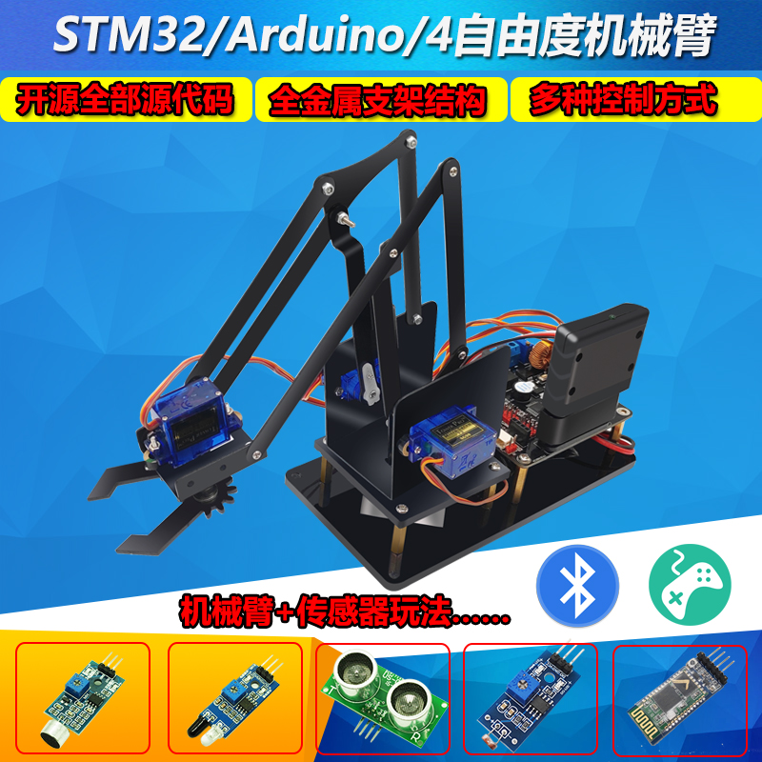
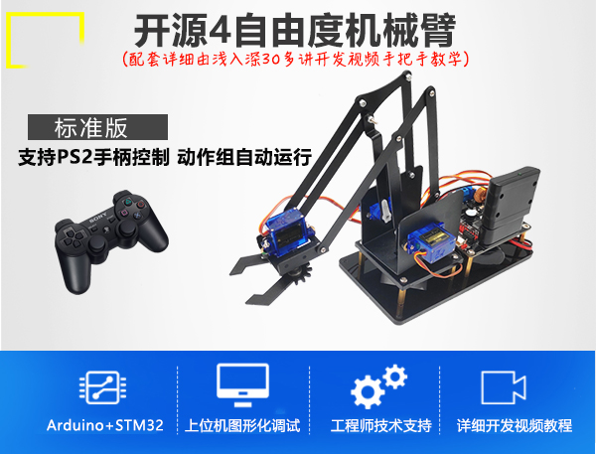
Arduino robot arm
A programmable robot arm

Slide 45
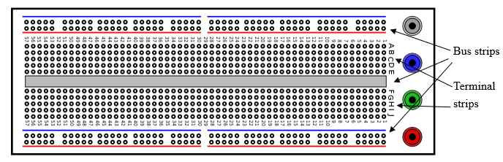
Usage of breadboard
A breadboard is a constructing base for prototyping of electronic circuits without soldering. The layout of a typical breadboard is made up from two types of areas, called strips. Strips consist of interconnected electrical terminals. The terminal strips are used to hold the electronic components while the bus strips are used to provide power to the electronic components. For each row of the strips, the slots are interconnected, e.g. the terminal strips ABCDE of the following diagram are interconnected.

Slide 46
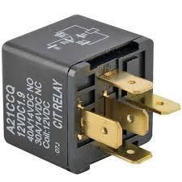
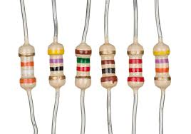
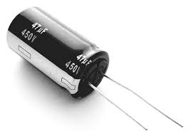
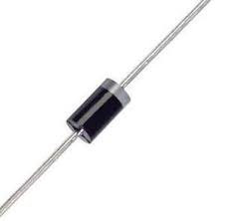
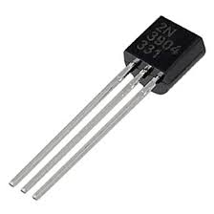
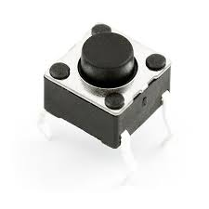
Electronic component basic
Resistor
Diode
Light emitting diode
Transistor
Relay
Capacitor
Push button

Slide 47
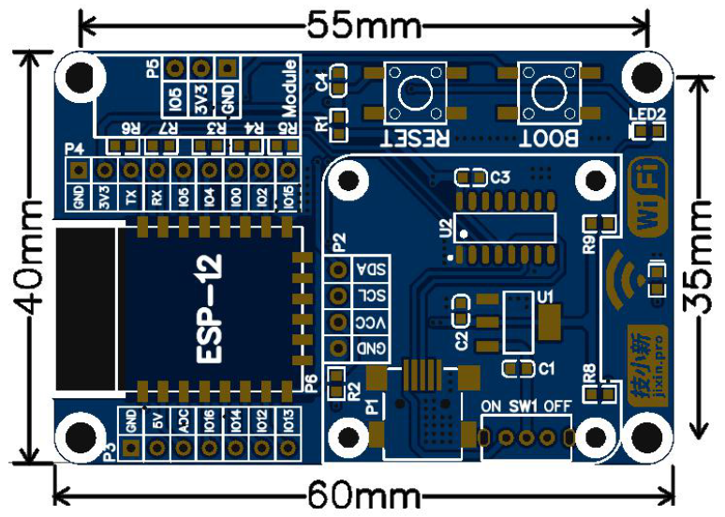
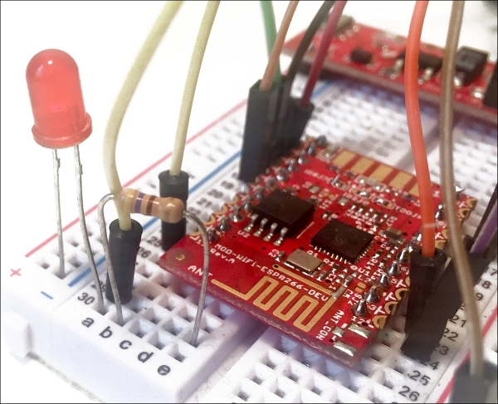
breadboard evaluation
The prototype circuit can be built by connecting the components using some jumper wires on the breadboard
After evaluation, the PCB can be designed and the components can be soldiered on it

Slide 48
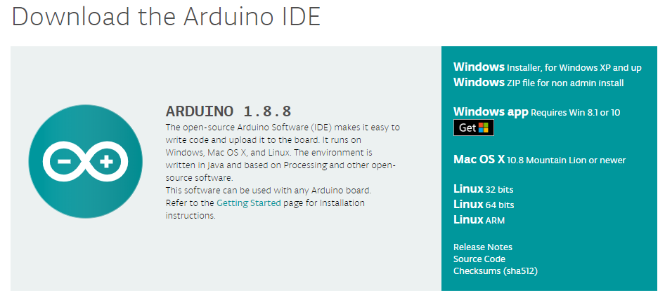
Arduino Integrated Development Environment
Download at Arduino.cc: https://arduino.cc/
Unzip the file to an appropriate location
Run Arduino.exe

Slide 49

Arduino IDE
Menu
Editing area
Message area

Slide 50
Arduino program structure
An Arduino program is known as sketch.
It consists of two parts
Setup function: it contains a set of instructions for the Arduino to execute once only, each time it is reset or turned on.
Loop function: it tell the Arduino to execute an instruction over and over until the power is shut off or the reset button is pressed.

Slide 51

Configuration for Arduino ide
Steps:
Start the Arduino IDE and open the Preferences window.
Enter the following URL into the Additional Board Manager URLs field: https://raw.githubusercontent.com/espressif/arduino-esp32/refs/heads/master/package/package_esp32_index.template.json

Slide 52

Configuration for Arduino ide
Steps:
Open Boards Manager install the ESP32 Dev Module, version 2.0.16

Slide 53



Configuration for Arduino ide

Slide 54

Configuration for Arduino ide

Slide 55

Configuration for Arduino ide
Steps:
Open Mange Libraries from the Sketch | Include Library menu and install the following libraries
NTPClient by Fabrice Weinberg Version 3.2.1
Arduinojson by Benoit Blanchon Version 6.19.4
ESP32Time 2.0.0 by fblego Version

Slide 56
Resource management using Github
The resources can be assessed in
https://github.com/jameschau2014/IoTplatform
Download aLocAiRTLTH.zip, unzip it to the document->Arduino folder
Open the aLocAiRTLTH_VTC.ino in the Arduino IDE
Connect the STEM board to the computer via the USB cable and set the appropriate COM port in the Arduino IDE.
Press the Verify button to compile the programs

Slide 57

Resource management using Github
The resources can be assessed in
https://github.com/jameschau2014/IoTplatform
Download aLocAiRTLTH.zip, unzip it to the document->Arduino folder
Open the aLocAiRTLTH_VTC.ino in the Arduino IDE
Connect the STEM board to the computer via the USB cable and set the appropriate COM port in the Arduino IDE.
Press the Verify button to compile the programs

Slide 58

Compile and upload the program

Slide 59

Success!

Slide 60

WiFi Connection
In the source code aLocAiRTLTH_VTC.ino, find line 444 and 445, change your WiFi access SSID and password

Slide 61
Sensor connection and result display
Connect CO2 or TEMP sensor to any port on the board via the cable
Reset the STEM board by pressing the red button
Open the Serial Monitor in the Tools Menu and set the baud rate to 115200
The result can be displayed on the Serial Monitor
Notice that the Air quality will be displayed on the onboard OLED display

Slide 62


Slide 63

Test the data logging
Modify the code in line 102 of SHTC3_Test.ino, “client.print(String("GET /dweet/for/myesp8266?temperature=")…” into “client.print(String("GET /dweet/for/your_name?temperature=")”

Slide 64

Test the data logging
Read your logged data by assessing: https://dweet.io/get/latest/dweet/for/your_name

Slide 65

Show data in dash board
Access: https://dweet.io/follow/james_chau_2024

Slide 66



Data logging using Google sheet and apps script
Data collected by the IoT device can be logged into an online spreadsheet for further analysis
Google sheets and app script script

Slide 67

Prepare a Google Sheet
Click blank spreadsheet in Google Sheet
And input the necessary data shown on new page

Slide 68

Spreadsheet string
Spreadsheet name
Column title
Sheet name

Slide 69

Open the Apps Script
Press Apps Script in the Extensions menu

Slide 70

Modify the Apps Script
Copy the program in the apps script template.txt into the apps script editor
Change the sheet_id and sheet_name in lines 9 and 10 with your own Spreadsheet string and Sheet name

Slide 71


Deploy the Apps Script
Press the deploy button->new deployment
Change Anyone to “who has access”, then press deploy

Slide 72

Copy the web app URL

Slide 73

Modify the program
In the source code SHTC3_Test.ino, find line 7 and paste your web app URL string
Upload the program to the STEM board

Slide 74

Logging results

Slide 75
Open source Arduino project
Arduino projects are usually open-sourced so that the other can modify and improve the project
Source:
https://create.arduino.cc/projecthub
https://howtomechatronics.com/arduino-projects/
https://circuitdigest.com/arduino-projects
Textbook

Slide 76
Summary
Smart Location IoT kit and IOT history are introduced
Wireless communication technology is introduced
Some electronic components are introduced
Data manipulation and analysis using STEM board

Slide 77
Thank you…

